Slide 1
Project Hotel Booking Analysis
Srinath Maharaj

Slide 2
Agenda
To discuss the analysis of given hotel booking data set for year 2018 – 2020 using Power BI.
We will do analysis of dataset and try to find out key factors driving the hotel bookings trends
- Data cleaning operations are done to ensure the dataset’s integrity and accuracy in SQL server.
- Connected the dataset to Power BI, leveraging its robust visualization capabilities to craft insightful and visually appealing dashboards.

Slide 3
Exploratory Data Analysis
We will now see the results from Power BI answering various questions.
Which agent makes the most no. of bookings?
Which room type is in most demand and which room type generates the highest adr?
Which meal type is the most preffered meal of customers?
What is the percentage of bookings in each hotel?
Which is the most common channel for booking hotels?
Which are the most busy months?
From which country most of the guests are coming ?
How long do people stay at the hotels?
Which hotel seems to make more revenue?
Which hotel has a higher lead time?
What is preferred stay length in each hotel?
Which hotel has higher bookings cancellation rate.
13. Which hotel has a high chance that its customer will return for another stay?
14. Which channel is mostly used for the early booking of hotels?
15. Which channel has a longer average waiting time?
16. Which distribution channel brings better revenue-generating deals for hotels?
17. Which significant distribution channel has the highest cancellation percentage?
18. Does a longer waiting period or longer lead time causes the cancellation of bookings?
19. Whether not getting allotted the same room type as demand is the main cause of cancellation for bookings?
20. Does not alloting the same room as demanded affect adr?
21. What is the trend of bookings within a month?
22. Which types of customers mostly make bookings?
23. Do we required more parking lot space?

Slide 4
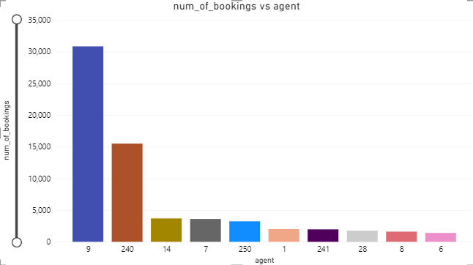
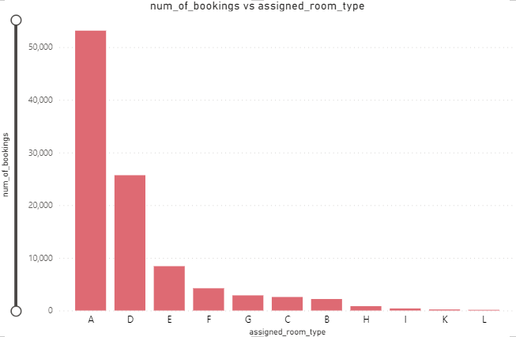
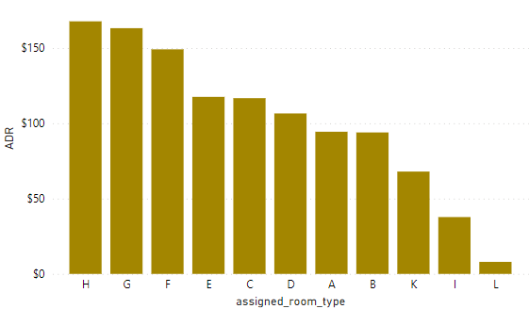
Agent with No.9 made most of the bookings.
Type A room is most demanded by customers.
Highest adr(average daily rate) generating rooms are H, G, F.
Hotels should increase the no. of room types of A & H to maximise revenue.

Slide 5
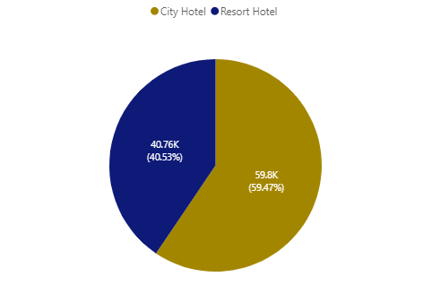
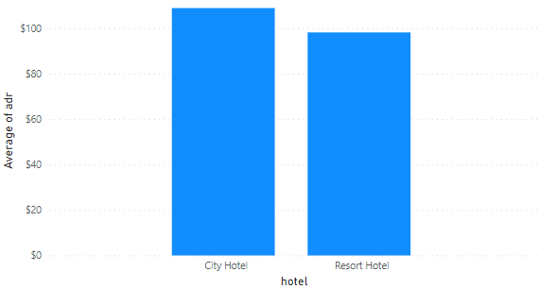
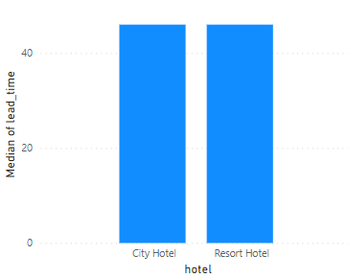
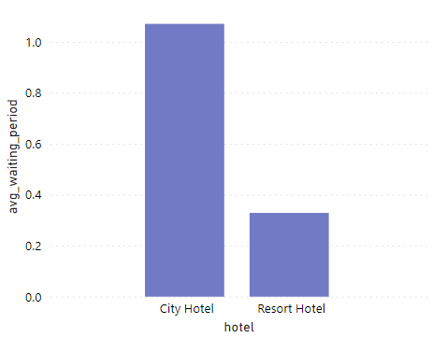
Around 60% bookings are for City Hotel with 59800 total bookings and 40% bookings are for
Resort Hotel with 40760 total bookings.
Average ADR of City Hotel is slightly higher than that of Resort Hotel, City hotel seems to be
making slightly more revenue.
City hotel & Resort hotel has same median lead time. Also median lead time is significantly higher in
each case, this means customers generally plan their hotel visits way to early.
City hotel has significantly longer waiting time for confirmation, hence City Hotel is much busier
than Resort Hotel.

Slide 6
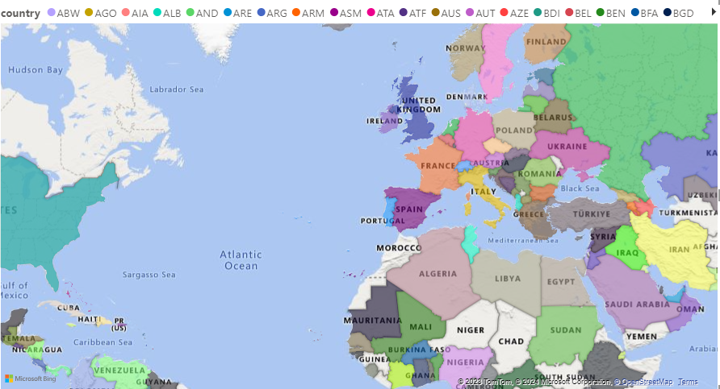
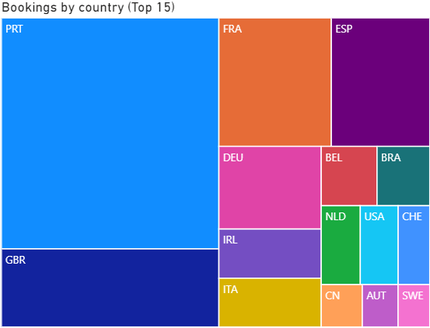
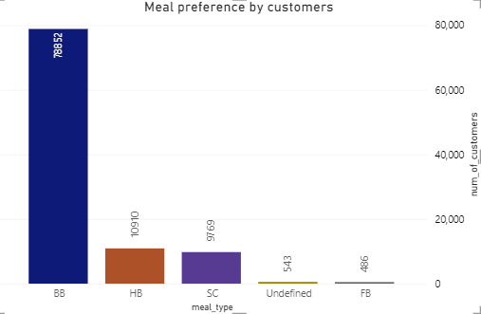
Most of the guests come from European countries like UK, France, Italy, Ireland,
Germany etc, with highest number of guests from Portugal (PRT)
BB(Breakfast & bed) is the most preferred meal type by customers.

Slide 7
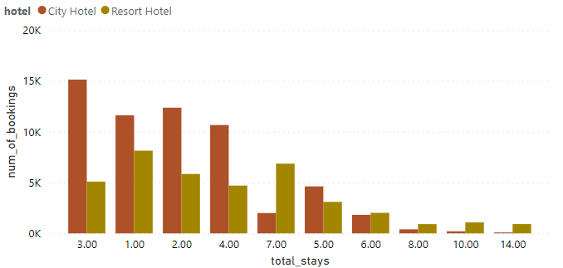
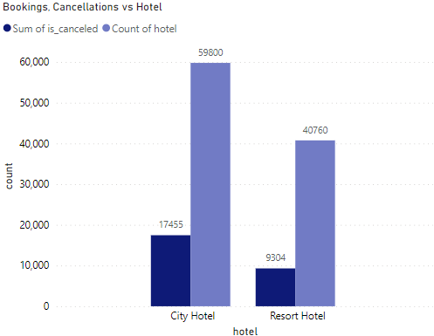
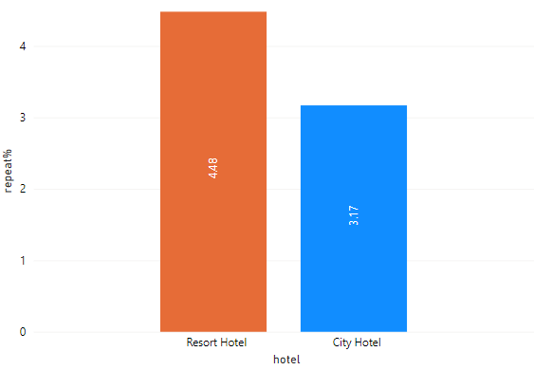
Most common stay length is <4 days, generally people prefer City hotel for
short stays, but for longer stays, Resort hotel is preferred.
Nearly 30% of City hotel bookings( i.e., 17,455 of 59,800) & 23% of Resort hotel
bookings (i.e., 9,304 of 40,760) got cancelled.
Both of hotels have small percentage of customers that will repeat, Resort hotel
has slightly higher repeat% than City hotel

Slide 8
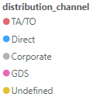
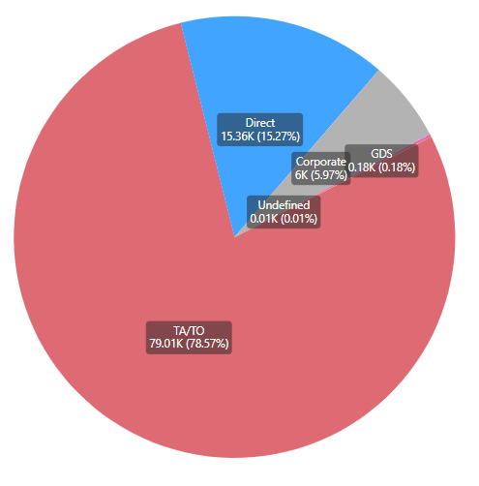
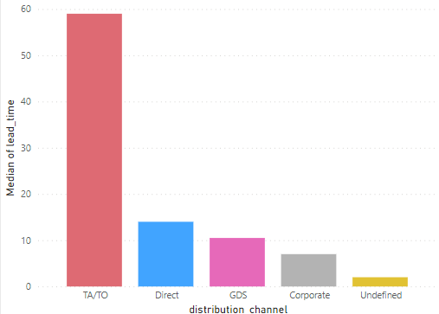
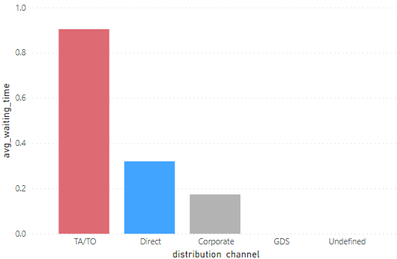
Most common channel for booking is TA/TO (Travel Agents/Tour Operators)
TA/TO channel has highest lead time(median), this means customers use this channel for early bookings/who plan ahead of time for visits.
Waiting time (avg) i.e., num of days booking in waiting list before confirmation is also high for TA/TO channel. One may have to wait a little longer to confirm booking of rooms.

Slide 9
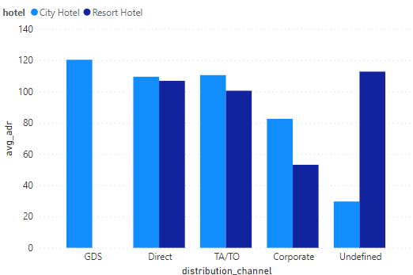
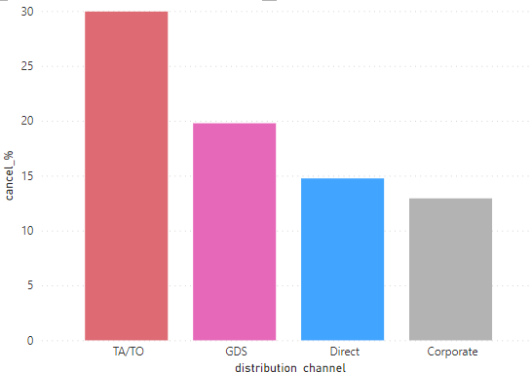
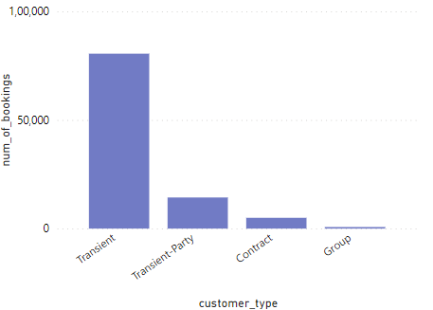
GDS channel brings higher revenue generating deals for City hotel despite less percentage of bookings, followed by Direct bookings. City Hotel can work to increase outreach on GDS channels to get more higher revenue generating deals.
Resort hotel has more revenue generating deals by direct and TA/TO channel. Resort Hotel need to increase outreach on GDS channel to increase revenue
Bookings done through TA/TO are 30% more likely to get cancelled.
Transient type of customer has highest number of bookings

Slide 10
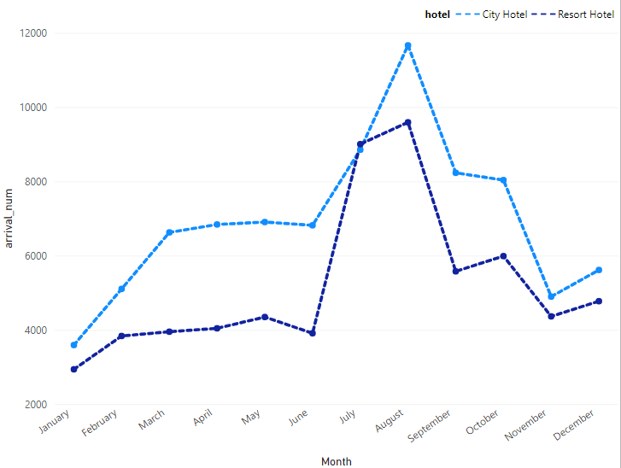
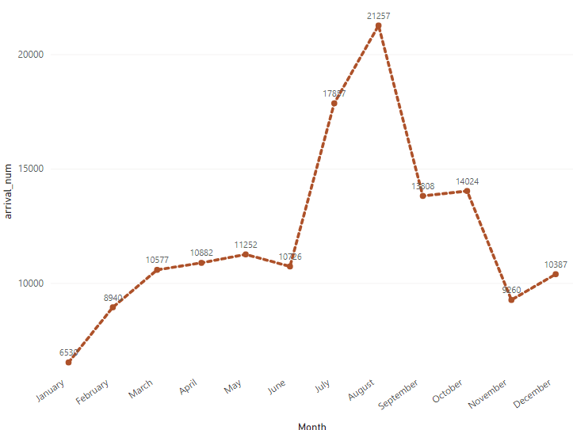
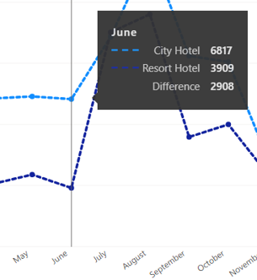
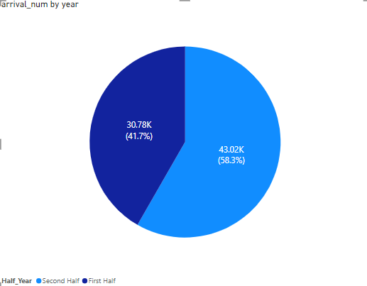
Number of guests was higher for City hotel(83179) than Resort Hotel(62321)
Number of bookings increased from the month of July to August.
At 21257, August had the highest no of guests and was 225.53% higher
than January, which had the lowest no of guests at 6530.﻿
In the month of June, num of guests for City hotel and Resort hotel diverged the most, when City Hotel were 2908 higher than Resort Hotel.
Second Half accounted for 58.3% of num of guests arrival.

Slide 11
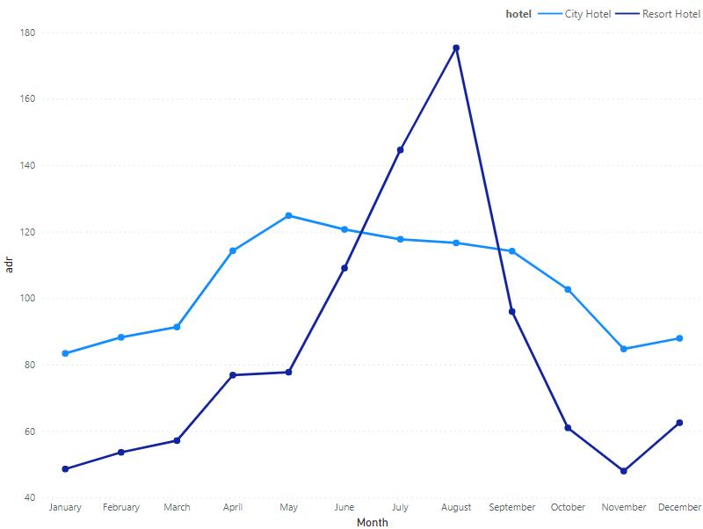
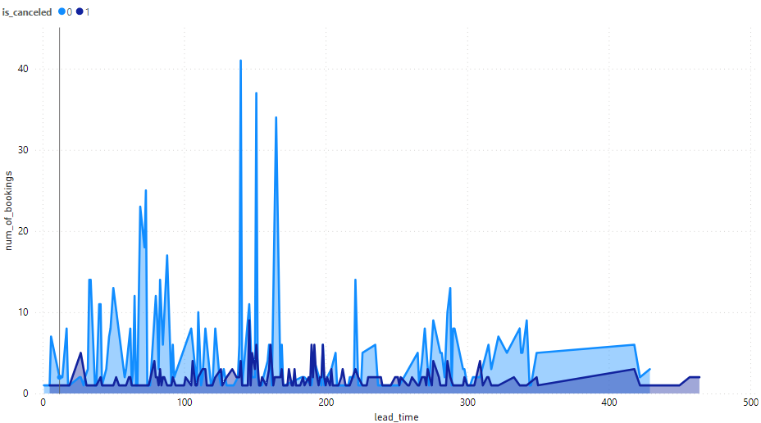
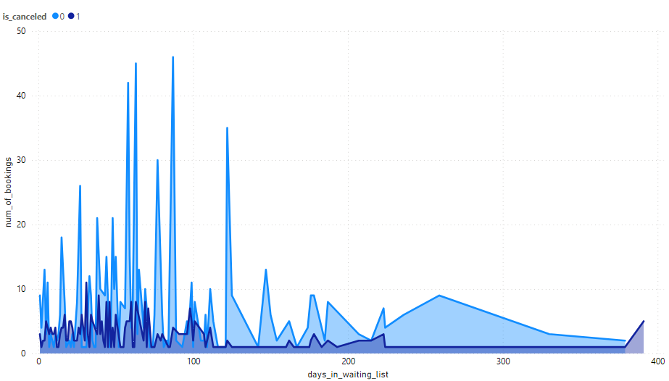
Revenue aspect looks different, the Resort Hotel receives more revenue with respect to City Hotel during middle of year though the no of bookings of city hotel are more.
From May to August, there was rapid increase in ADR, reaches peak in August.
From below two graphs, we see that either lead_time or days_in_waiting_list has no effect on cancellation of bookings as bookings not cancelled even with same waiting time are significantly more.

Slide 12
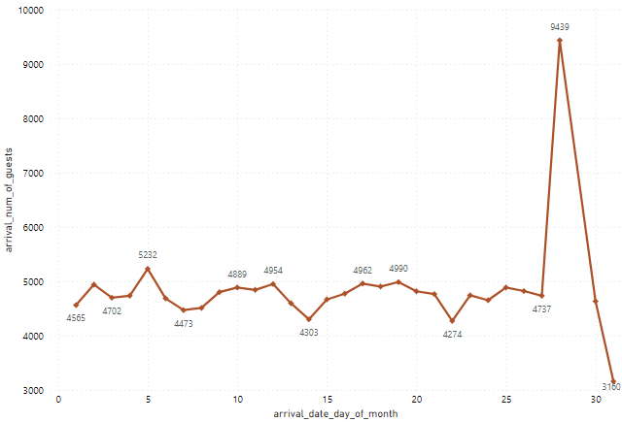
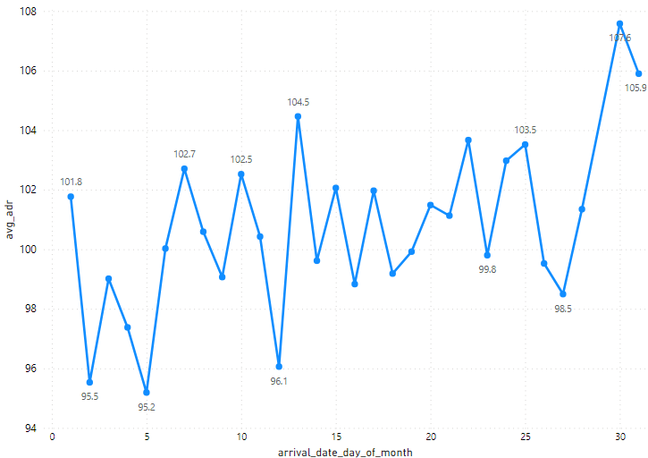
We can see small peaks in arrival number of guests at regular interval of days, this may be due to increase in arrival weekend.
Average ADR tends to go up as month ends.

Slide 13
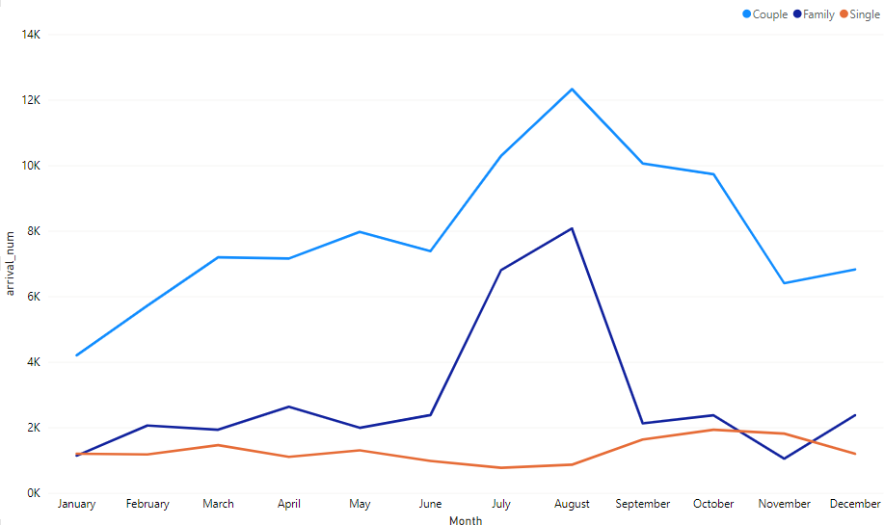
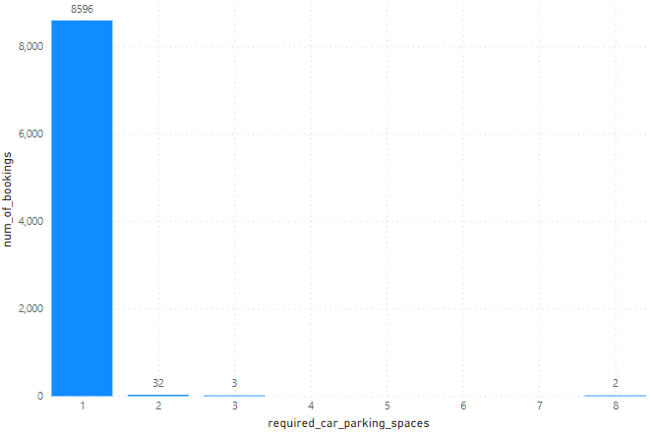
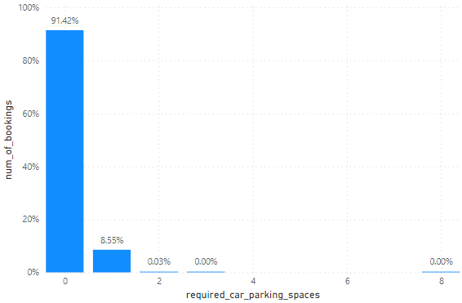
Most bookings are done by couple (although we are not sure that they are couples as data doesn’t tell about that)
We can see from graph sudden surge in arrival num of guests(couples and family) in months of July & August, so we can plan better facilities for this type of customers during these months.
Looking at the chart, atleast one number of car parking is mandatory for each hotel. 91.42% of bookings does not need parking space, 8.55% requires one car sparking space.

Slide 14
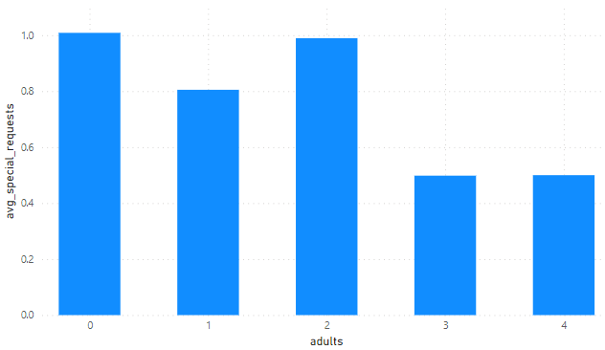
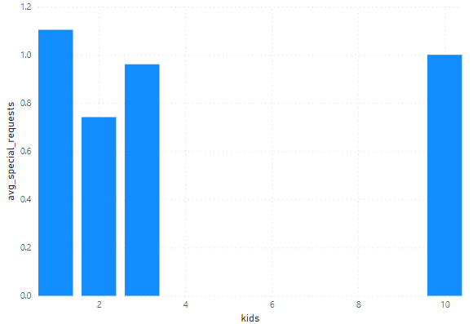
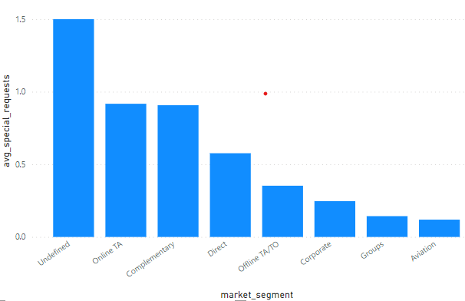
To check whether a hotel was likely to receive a high number of special requests.
All of market segment mostly have special request.
Customer such as adults or with kids have special request generally.

Slide 15
THANK YOU

